Slide 1

SMART INDIA HACKATHON 2026
TITLE PAGE
Problem Statement ID –
Problem Statement Title-
Theme-
PS Category- Software/Hardware
Team ID-
Team Name (Registered on portal)

Slide 2
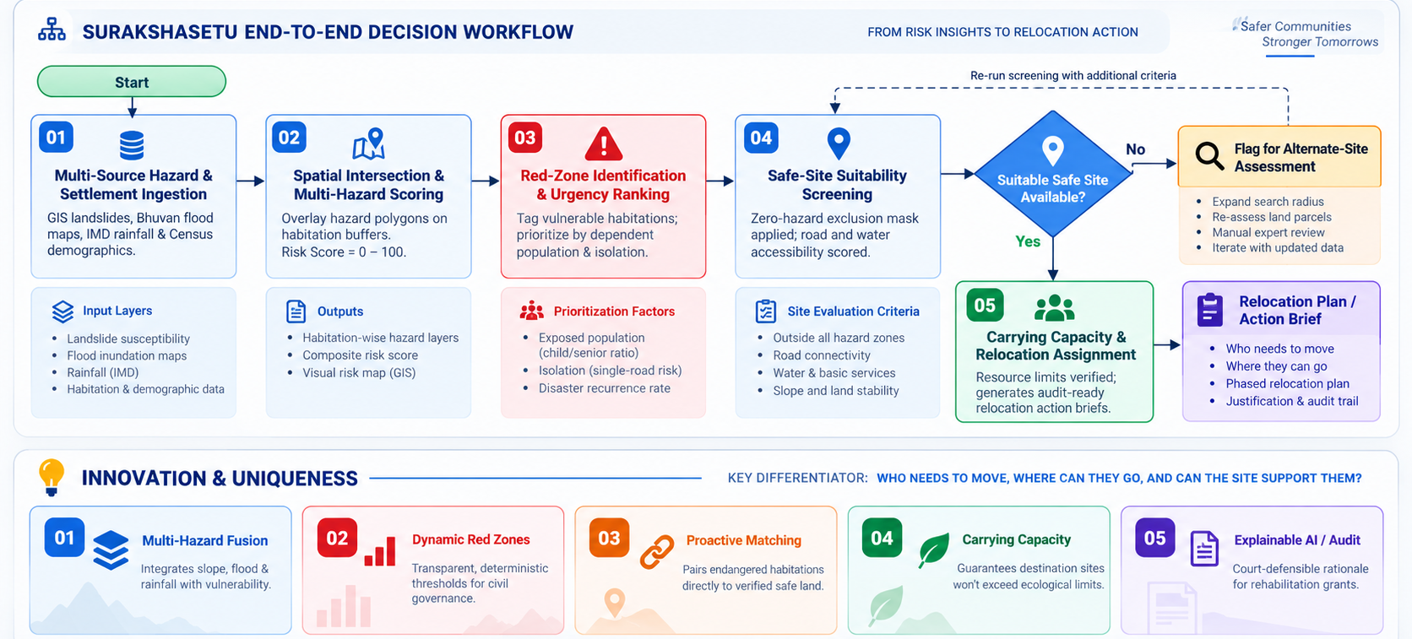
SURAKSHASETU
Your Team Name
Proposed Solution

Slide 3
FEASIBILITY AND VIABILITY
GeoKavach
logo space
GeoKavach — Hazard Intelligence and Relocation Decision Support
Technical Feasibility
Operational Viability
Practical Implementation
Integrates official disaster warnings, earthquake observations and weather forecasts.
Interactive maps combine live hazard information with saved field assessments.
Existing risk and capacity rules support relocation planning.
A unified dashboard helps users explore warnings, locations and relocation options.
Public data sources and reusable components support an affordable prototype.
Role-based workflows support coordination between field teams and decision-makers.
Begin with a proposed pilot in one district.
Validate warning coverage, field assessments and destination capacity with local authorities.
Expand gradually after usability testing and operational feedback.
Data Availability
Show source timestamps, availability status and clearly labeled regional references.
01
Official feeds may be delayed or lack precise warning boundaries.
01
Location Accuracy
Distinguish precise warning geometry from regional advisories; require local verification.
02
A regional warning may not apply to a user’s exact location.
02
!
Connectivity
03
Use lightweight views and retry controls; proposed offline access to essential guidance.
03
Potential
Challenges & Risks
Weak networks can interrupt access during emergencies.
Strategies to
Address Challenges
Data Privacy
Apply consent controls, authenticated access, role-based permissions and minimal data collection.
04
Location, assessment and emergency-request data require protection.
04
Relocation Readiness
Require fresh field assessments, capacity checks and authorized approval before relocation.
05
Shelter capacity, road access and site conditions can change.
05
Decision-support prototype. Local verification and authorized approval remain essential.
3
Notes:
GeoKavach is a decision-support prototype. The district pilot and offline access are proposed work. No guaranteed prediction accuracy, certified safe locations, complete warning coverage, or automatic evacuation decisions are claimed. Content supplied by the user. SIH logo reused from the supplied PPT SIH.pptx.

Slide 4
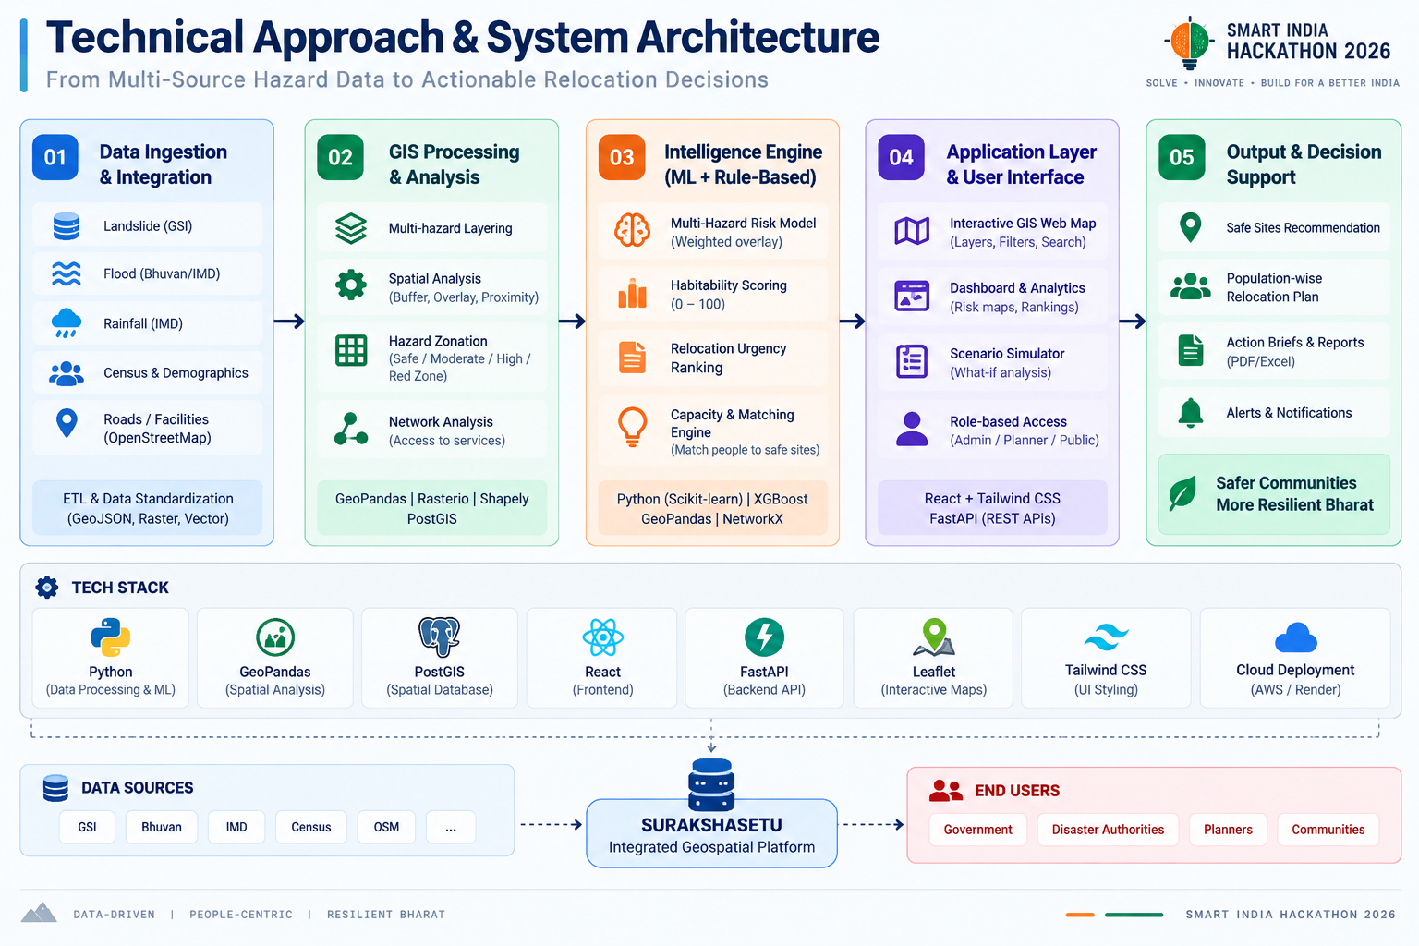
TECHNICAL APPROACH
Your Team Name

Slide 5
FEASIBILITY AND VIABILITY
Your Team Name

Slide 6
IMPACT AND BENEFITS
Your Team Name
Potential impact on the target audience
Benefits of the solution (social, economic, environmental, etc.)

Slide 7
RESEARCH AND REFERENCES
Your Team Name
Details / Links of the reference and research work

